Slide 1

Introduction to Financial Accounting

Slide 2
LEARNING OBJECTIVES
Be aware about the concept of Business and its objectives
Understand the concept of accounting
Learn about the Accounting as Information System.
Identify the various users of Accounting information
Distinguish between Financial Accounting and Management Accounting .
Understand the objectives of Financial Accounting.
Explain the various assumption underlying preparation of financial accounting.

Slide 3
Business
A business (also known as enterprise or firm) is an organization involved in the trade of goods, services, or both to consumers.
It is an activity of making, buying, selling or supplying goods or services for money.
Business involves the investment of money and earning reasonable return on it.
There are many forms of business that includes (i) Sole Proprietorship (ii) Partnership (3) Company, or (4) Co-operative.
Irrespective of the nature and type of business, an enterprise has to invest capital.

Slide 4
Using Capital, the enterprise can acquire assets.
The economic resources employed by an enterprise are called assets.
Assets may be classified into two categories: Fixed assets and Current assets
Fixed assets are those assets which are permanently held by the enterprise. For example Plant, Machinery, Land, building etc.

Slide 5
Current Assets are those assets that used for a particularly accounting period and have limited life. These assets can be converted into cash easily.
Examples of current assets includes Stock in Trade, Cash in Hand and Bank, Account Receivables(Debtors)
Irrespective of type of business, it is essential to keep a record of business transactions that have economic effect.
The process of recording the business transactions is known as Book Keeping.

Slide 6
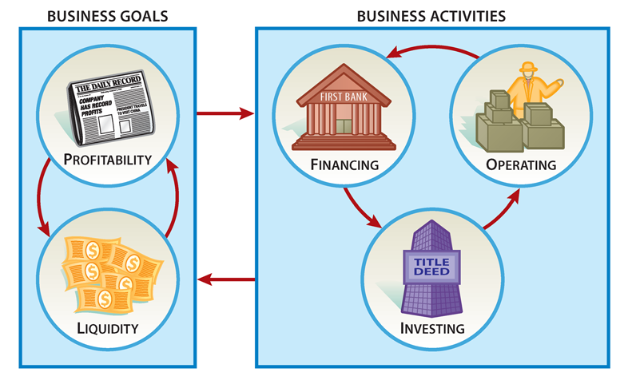
Business Goals and Activities

Slide 7
Accounting -a process of identifying, recording, summarizing, and reporting economic information to decision makers in the form of financial statements
Financial Accounting - focuses on the specific needs of decision makers external to the organization, such as stockholders, suppliers, banks, and government agencies.

Slide 8
Accounting –Language of Business
Accounting is often called the language of business.
The function of language is to facilitate communication among individuals in a society.
Accounting is the common language used to communicate financial information to various stakeholders.
Accounting main objective is to provide information that is useful in making business and economic decisions.

Slide 9
Accounting is a principal means of communicating financial information to outsider.
AAA states that “essentially accounting is an information system”.
Accounting system process business transactions to provide information to interested parties.

Slide 10
Accounting as a “Language” of Business
Accounting
Record Transactions
Who are the users?
Communicates to Users
Investors
Creditors
Government
Management

Slide 11
Accounting Information System
Inputs
Processing
Outputs
Users
Business transactions and Events
Accounting principles
and procedures
Financial
Statements
and reports
Investors, lenders, managers

Slide 12
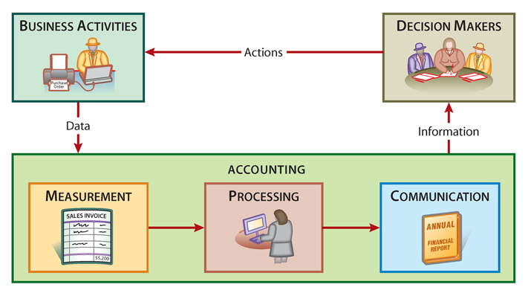
An Accounting Information System

Slide 13
The Accounting Information System
Business transactions and events
Inputs
Accounting concepts and conventions
Processing
Financial Statements and reports
Outputs
Investors Lenders and Managers
Users

Slide 14
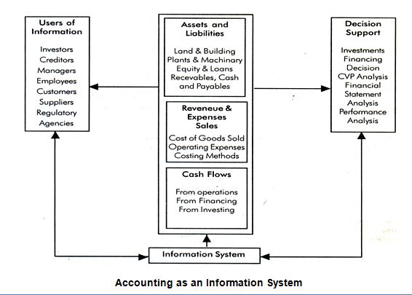

Slide 15
Accounting Information and Economic Decisions
Accounting information is useful in making a number of decisions that affect the income or wealth of organizations.
Accounting reports are designed to meet the common information needs of most decision makers. Some examples of decisions that are based on accounting information are as follow: -
  Assessment of the ability of the business to pay to employees
  Ability of the firm to meet the payment schedule of loan and other liabilities
  Decisions concerning when to buy, hold or sell an equity investment.
  Determination of distributable profits and dividends

Slide 16
Accounting as an Aid to Decision Making
Accounting information is useful to anyone who makes decisions that have economic results.
  Managers want to know if a new product will be profitable.
  Owners want to know which employees are productive.
  Investors want to know if a company is a good investment.
  Creditors want to know if they should extend credit, how much to extend, and for how long.
  Government regulators want to know if financial statements confirm to requirements.

Slide 17
Financial and Management Accounting
The major distinction between financial and management accounting is the users of the information.
  Financial accounting serves external users.
  Management accounting serves internal users, such as top executives, management, and administrators within organizations.

Slide 18
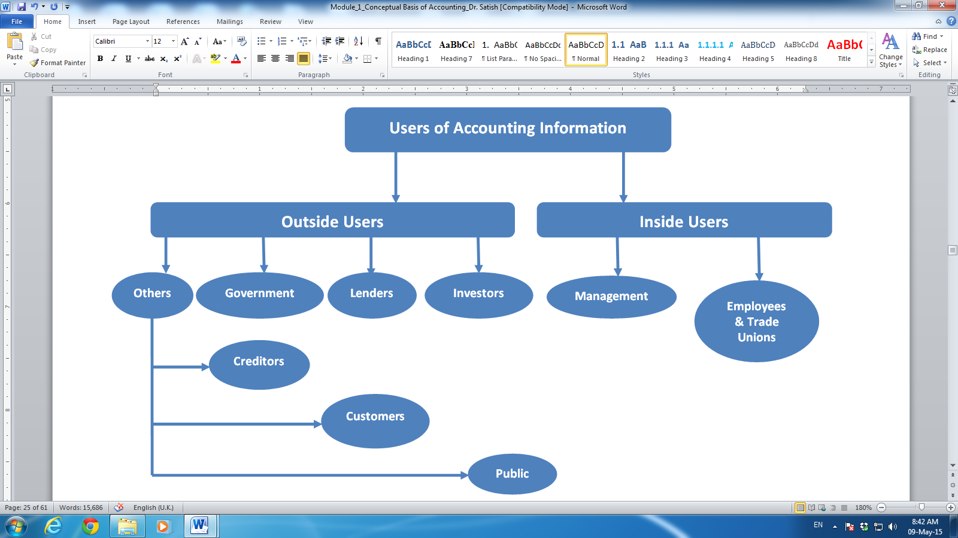
User of Accounting Information

Slide 19
User of Accounting Information
INVESTORS
  Investors are major recipients and user of financial statements of business enterprise. As providers of risk capital, investors (individual & institutional) are concerned with risk inherent in, and return provided by, their investment.
  Investors need financial information to decide which investment to buy, sell as well as the timing of purchase or sales of those investments.
  Need information about the profitability, dividend yield, earnings per share in order to assess the quality and the price of shares of a company

Slide 20
LENDERS
  Lenders includes banks and debenture/bond holders.
  They need to know the financial stability of the business who approach them for funds.
  Lenders need information about the profitability and solvency of the business in order to determine the risk and interest rate of loans.
  Banks use credit evaluation benchmarks based on information derived from financial statements when determining the amount of loan, interest rate , repayment period and security require for giving loan.

Slide 21
MANAGEMENT
  Managers also use financial information in many of their own decisions.
  Management needs information for planning, policy making and evaluation of various plan and policies.
  As management is responsible for reporting enterprise performance to owners and others, it monitors the key financial indicators which appears in the financial statements of the enterprise.
  Further, management studies the competition and seeks to make financial comparisons of its performance against competitors’ performance
  Some times, remuneration of the managers is related to reported profits or other accounting based measures.

Slide 22
SUPPLIERS AND TRADE CREDITORS
  Suppliers and creditors are another major stakeholder interested in financial statements of the company.
  Suppliers and trade creditors extend goods on credit to the enterprise.
  Need information about the liquidity of business in order to access the ability to repay the amounts owed to them.
  They are generally interested in an enterprise over a shorter period than lenders (expect if they are not continually supply goods to the business)

Slide 23
EMPLOYEES AND TRADE UNION
  Employees are interested in information about the enterprise as well as its general operations, stability and profitability.
  Present employees clearly have an interests in the financial affairs of the enterprise that employ them as it is main source of their income.
  Potential employees may also like to know the financial affairs of the enterprise and past employees have a valid interest in the information to the extent their pensions are dependent on future prospects of the business
  Trade unions have a stake in financial reports of enterprise with whom they are engaged in wage negotiations.

Slide 24
GOVERNMENT
Need information about various businesses for statistics and formulation of economic plan.
They need information in order to regulate the business practices of enterprise, determine tax policies and other incentive schemes.
MOF and DCA have interest in the financial affairs of the company.
A number of regulatory agencies like SEBI, IRDA, and stock exchanges have a legitimate interest in the financial reports of publically held companies for the efficient operations of capital markets.

Slide 25
CUSTOMERS
Interested in long-tem stability of the business and continuance of the supply of particular products
PUBLIC
Need information about the trends and recent development of the business. Business employ number of people in a locality and may patronise local suppliers.

Slide 26
SECURITY ANALYST AND ADVISERS
  Investors and creditors seek the assistance of information specialists in assessing prospective returns.
  Information specialist serve the needs of investors by providing them with skilled analysis and interpretation of financial reports.
  Security analysts also collect information about firms through other means such as meetings with executives and filed field visits.
  Analysts reports are used by securities firms to recommended to their clients whether to buy, sell or hold their investments.

Slide 27
User of Accounting Information
S.No. | Users | Concerns
1 | Investors | Buy-sell decisions (right time to buy, sell or hold an investment). Monitoring of the company’s performance (satisfactory or unsatisfactory)
2 | Lenders | Repayment of loan and interest on time, collateral for the loan, rate of interest, etc.
3 | Government | Tax policies, for subsidies, monitoring of firms as to whether they overcharge customers, whether the company makes a proper disclosure of its financial results as per the law
4 | Creditors | Decisions about whether the company is a major customer, whether the company will be able to pay for its purchases in the future or not
5 | Customers | Information on whether the company is a reliable source of supply, and whether it will be able to service its products
6 | Management | Growth rate of the firm, concern about company earnings being an adequate profit in relation to its assets and performance of the firm
7 | Employees | Continuity and increment of the compensation provided by the firm

Slide 28
Assumptions For Accounting Measurement
Accounting involves measurement and communication of economic events.
Business transactions are external events that result into transfer or exchange of value between two or more parties.
Purchase of goods, collection of cash, repayment of loan are few example of business transactions.
Accounting record the effects of economic events only.
Accounting measurement are base on Four major assumptions

Slide 29
These assumptions are: (i) accounting entity (ii) going concern (iii) periodicity and (iv) money measurement .
Accounting entity
Going concern
Periodicity
Money Measurement

Slide 30
Objectives of Accounting
Income determination-is needed for rationale economic decision making, taxation, national statistics and reporting of stewardship.
Financial Reporting- includes the reporting on the financial position of the entity. Balance sheet summarizes what company own and owes to other at a particular date.
Disclosure- is one of the dimension of financial reporting that requires that all relevant and pertinent information is supplied to the information users.

Slide 31
FUNCTIONS OF ACCOUNTING
Recording
Managerial Function
Functions of Accounting
Legal Requirement
Communicating

Slide 32
Recording
The primary function of accounting relates to recording, classification and summarisation of financial transactions. It helps in knowing the operating results and financial positions.
The purpose of this function is to allow one to report regularly to the interested parties by means of financial statements.
Thus, accounting helps focus attention on the past performance of a firm and thus helps managers in their decision making for improving the future performance of a firm.

Slide 33
Managerial Function
Accounting assists in the decision-making process of a firm.
It enables one to compare day-to-day operations of a firm with predetermined standards or benchmarks set in the budget.
The variations of actual operations with predetermined standards and their analysis ultimately help managers in making informed decisions.

Slide 34
Legal Requirement
In every firm, accounting provides support to comply with legal requirements.
It offers a base for the preparation of various reports required by the legal authorities.
For example, in the case of registered firms, auditing is mandatory and accounting helps in generating all the necessary documents required for audit purpose.
Another good example is income tax statements of a firm.

Slide 35
Communicating
Accounting is known as the “language of business”.
Various transactions and the result of a company’s performance are communicated to users only through the process of accounting.
Accounting shows the real and true position of a firm.

Slide 36
LIMITATIONS OF ACCOUNTING
Financial Nature
Historical Nature
Measurement Unit
No information regarding Opportunity Cost

Slide 37


